Slide 1
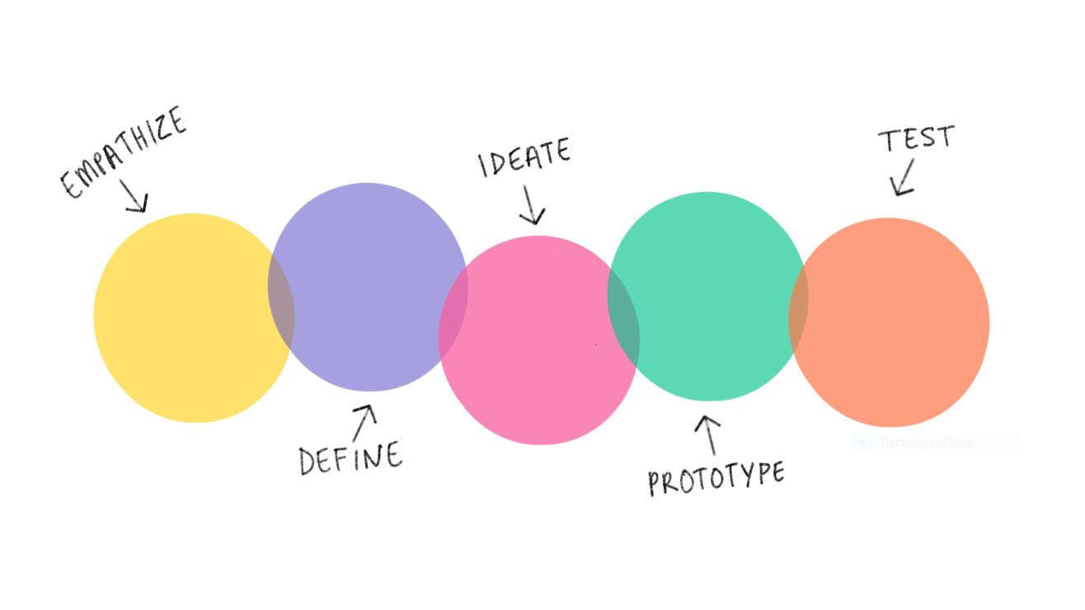
Jarvis x spotify
2
+
2
+
Oz, Luke & Cerys

Slide 2


Jarvis
2
+
2
+
2
+
Who/What is JARVIS?
Fandom (2021) J.A.R.V.I.S. Available from: https://disney.fandom.com/wiki/J.A.R.V.I.S. [Accessed 25 March 2022]

Slide 3
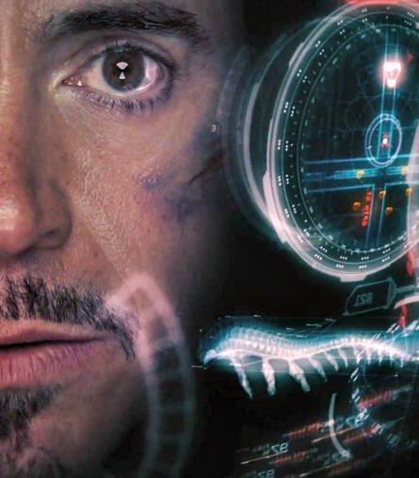
Jarvis & tony
2
+
Movies.2022 [online]. Available from: https://marvel-movies.fandom.com/wiki/Just_A_Rather_Very_Intelligent_System#Capabilities [Accessed 7 April 2022]. (Wiki Targeted, 2022)
2
+
How they interact?
Affordance – relationship between how an object and a user interact
Signifier – communicates the affordance to the user
Feedback – communicates an action you expect to happen as a consequence of the user’s interaction
Davis, E/Fandango (2016) Available from: https://www.fandango.com/movie-news/mark-zuckerberg-is-building-a-real-life-jarvis-just-like-tony-stark-in-the-iron-man-movies-750308 [Accessed 25 March 2022]
Norman, D.A, (2013) Design of Everyday Things. revised and expanded edition. Cambridge, Mass: MIT Press Ltd.

Slide 4
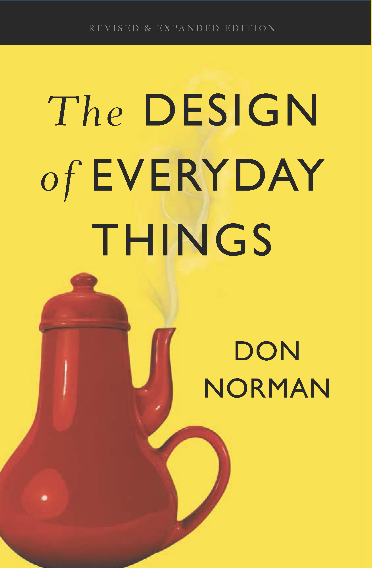
Don norman – The design of everyday things
Design Thinking
Human-centered design (HCD)
Find the root issue
Make multiple solutions
Propose the best solution
“Solving the right problem, and doing so in a way that meets human needs and capabilities”
“A brilliant solution to the wrong problem can be worse than no solution at all”
Norman, D.A, (2013) Design of Everyday Things. revised and expanded edition. Cambridge, Mass: MIT Press Ltd.
Norman, D.A, (2013) Design of Everyday Things. revised and expanded edition. Cambridge, Mass: MIT Press Ltd.

Slide 5
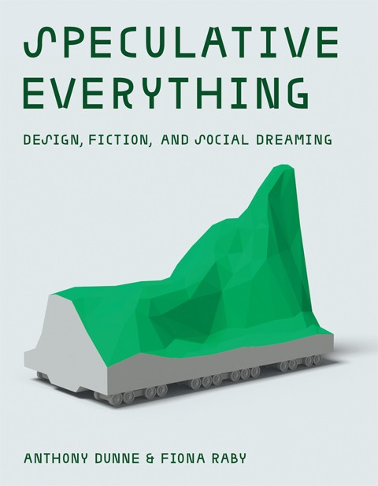
Speculative design
2
+
2
+
“Unsettle the present”
Addressing big societal problems and looking towards the future.
Introducing the concept of ‘Radical Design’ – A design that introduces a new way of seeing or perceiving a current societal situation
JARVIS exposes the world to new opinions regarding the ever-growing current fear of A.I ‘over-taking’ or simply running our lives.
Disrupts the present through the realism of Artificial Intelligence, JARVIS’ ability to talk and think for ‘himself’ making the prospect of him and others a-like seem more likely to happen.
Dunne, A, Raby, F. (2013) Speculative everything: design, fiction, and social dreaming. 1st ed. Cambridge, Massachusetts: The MIT Press.

Slide 6
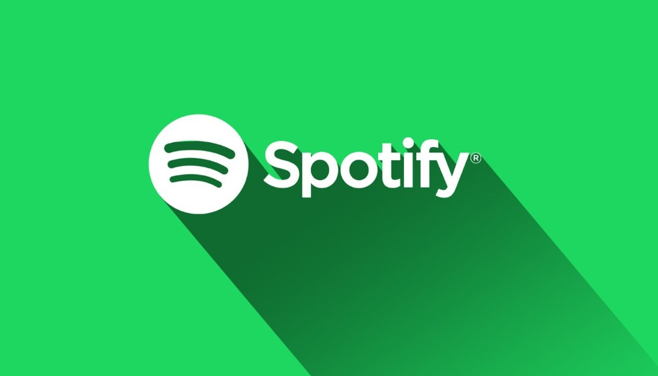
Spotify
2
+
2
+
History, Competitors, Future

Slide 7
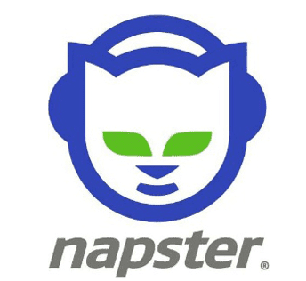
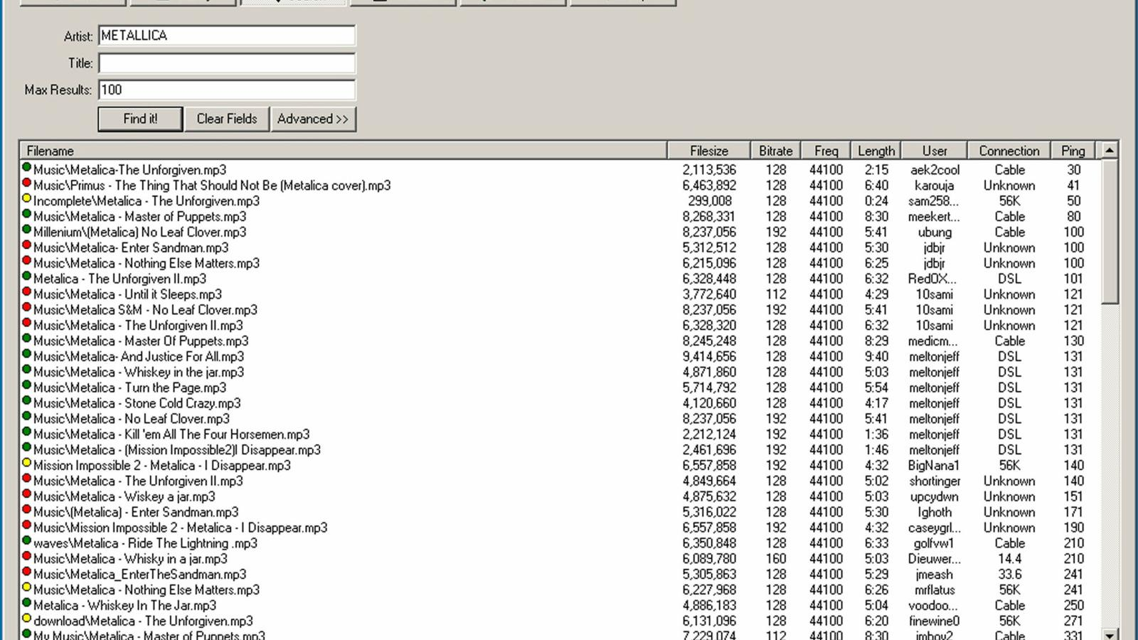
Napster and music services
The New York Times (2014), Napster Documentary: Culture of Free | Retro Report | The New York Times. Available from: https://www.youtube.com/watch?v=CKrdsGdLVQ8
[Accessed 20 March 2022]
2
+
Changing the music industry
Developed in 1998
Music became more accessible - download induvial songs instead of buying a whole album
70 million members by 2001
CD stores lost revenue and shut down
Itunes founded in 2003 – made distribution easier and cheaper
Harris. M (2022), Napster, Available from: https://www.lifewire.com/history-of-napster-2438592
[Accessed 25 March 2022]
Kopf. D (2022), Napster, yes that Napster, was just bought for $70 million, Available from: https://qz.com/1897131/napster-was-just-bought-for-70-million/ [Accessed 01 April 2022]

Slide 8
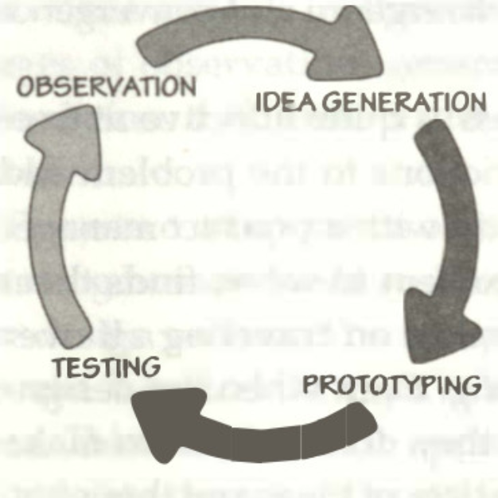
Founding
Leading Service
Founded in 2006
Streaming service
Provided a solution for music records which were suffering from illegal downloads
Only available in 6 large European Countries on launch
Went through a lot of prototypes/trials before going onto other countries for full release
Iterative Cycle of Human-Centred Design
Norman, D.A. (2013) Design of Everyday Things [diagram]. Cambridge, Mass: MIT Press Ltd, p. 212.

Slide 9
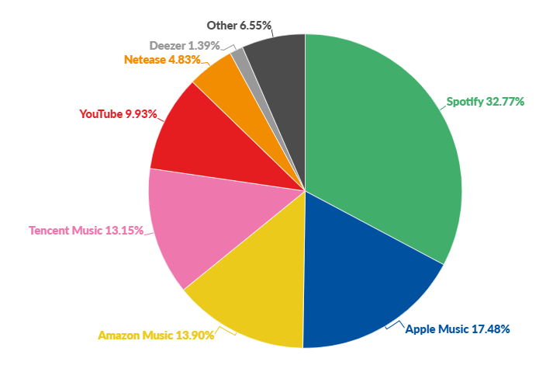
competitors
CNBC (2020), 'How Spotify Dominates Apple, Google And Amazon In Music'. Available from: https://www.youtube.com/watch?v=6viSSo12-PQ&list=WL&index=14
[Accessed 20 March 2022]
Is Spotify a Monopoly? (2020), Available from: https://economicforall.com/library/lecture/read/476171-is-spotify-a-monopoly [Accessed 1 April]
Revenue/Problems
Main Competitors: Apple Music, YouTube Music & Amazon Music.
Majority of revenue from subscriptions.
Free version brings revenue through Ads
Spotify as a Monopoly:
What is a Monopoly?
A company or business having exclusive control over a specific service.
Strong monopoly shown through monthly listeners
Also holds a monopoly over the “new” concept of ‘Streaming music on the Go’.
Curry, D. (2022) Music Streaming Marketshare, Available from: https://www.businessofapps.com/data/music-streaming-market/ [Accessed 25 March 2022]

Slide 10

Future plans
2
+
How can it stay number one?
Invested almost $500 million into podcasts
Revenue from advertisements
Teaming up with genius for lyrics of songs
Affordable premium plans – e.g., family plans
‘The Rise Of Podcasts And What Spotify Has To Do With It’ (2019) Epic Studios Events.22 March 2019 [online]. Available from: https://epic-tv.com/events/blog/the-rise-of-podcasts-and-what-spotify-has-to-do-with-it/#:~:text=Spotify%20was%20not%20the%20first,grew%20on%20Spotify%20by%20175%25. [Accessed 7 April 2022].
(‘The Rise Of Podcasts And What Spotify Has To Do With It’, 2019)
https://www.facebook.com/marketing91 (2019) Business Model of Spotify - How does Spotify make money? Marketing91.22 October 2019 [online]. Available from: https://www.marketing91.com/business-model-of-spotify/ [Accessed 7 April 2022].

Slide 11

Any questions?
2
+
2
+

